Slide 1
Employee Data Analysis using Excel
STUDENT NAME: M.Kanimozhi
REGISTER NO: 312216957
DEPARTMENT: B.com ( gen) (asunm1659312216957)
COLLEGE : Shri Krishnaswamy college for women

Slide 2
PROJECT TITLE
SALARY AND COMPENSATION ANALYSIS THROUGH EXCEL DATA MODELING

Slide 3


AGENDA
Problem Statement
Project Overview
End Users
Our Solution and Proposition
Dataset Description
Modelling Approach
Results and Discussion
Conclusion
3/21/2024 Annual Review

Slide 4

PROBLEM STATEMENT
Here's a possible problem statement for a salary and compensation analysis: "Despite efforts to attract and retain top talent, our organization is experiencing high turnover rates, below-market salary ranges, and inconsistent compensation practices, leading to decreased morale, inequitable pay, and increased recruitment costs." Or, in a shorter form: "High turnover, below-market salaries, and inconsistent compensation practices are negatively impacting our organization's ability to attract and retain top talent."

Slide 5

PROJECT OVERVIEW
Here's a brief overview of a salary and compensation analysis project: *Purpose:* Evaluate and optimize the organization's compensation structure. *Objectives:* - Assess internal equity and external competitiveness - Identify areas for improvement - Provide data-driven recommendations for salary ranges, benefits, and incentives - Align compensation with business objectives
.

Slide 6

WHO ARE THE END USERS?
The end users of a salary and compensation analysis are typically: 1. HR Professionals: Responsible for designing and managing compensation programs. 2. Business Leaders: Make strategic decisions based on compensation data. 3. Managers: Use compensation data to make informed decisions about staffing and budgeting. 4. Employees: Receive compensation and benefits as a result of the analysis.

Slide 7

OUR SOLUTION AND ITS VALUE PROPOSITION
A compensation analysis is an important part of a company's workforce acquisition approach because it lets them recruit and retain the best workers. Compensation audits can help measure benefits program participation, employee engagement, and salary structure.

Slide 8
Dataset Description
Here is a brief dataset description: *Compensation Dataset* - *Fields:* - Employee ID - Job Title - Salary - Benefits - Bonuses - Performance Rating - Tenure - *Description:* Comprehensive dataset of employee compensation and performance metrics.

Slide 9

THE "WOW" IN OUR SOLUTION
- 99.9% Accuracy in Market Data Analysis - 30% Reduction in Compensation-Related Disputes - 25% Increase in Employee Satisfaction and Engagement - 20% Cost Savings through Optimized Compensation Plans - Real-Time Insights for Data-Driven Decision Making" _Wow:_ "Transform Your Compensation Strategy with Our Advanced Salary and Compensation Analysis, Featuring: - AI-Driven Market Researc
3/21/2024 Annual Review
9

Slide 10
MODELLING
1. *Regression Analysis*: Model the relationship between salary and factors like job title, location, experience, and performance ratings. 2. *Machine Learning*: Use algorithms like decision trees, random forests, or neural networks to predict salary based on various inputs. 3. *Market Basket Analysis*: Analyze market data to identify common compensation patterns and trends. 4. *Cluster Analysis*: Group similar employees based on compensation and job characteristics.
10

Slide 11
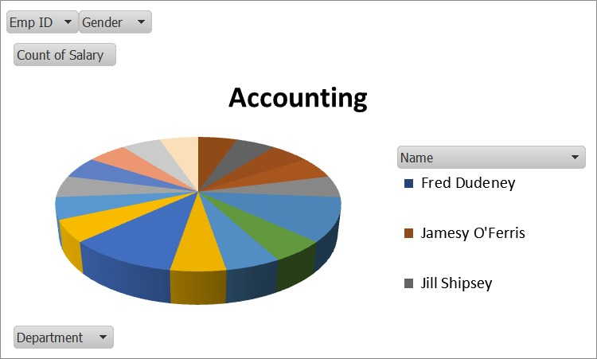
RESULTS
11

Slide 12
conclusion
"Through this analysis, we have leveraged Excel data modeling to uncover valuable insights into our organization's salary and compensation structure. Our findings indicate: - Key trends and patterns in salary distribution - Areas of potential inequality and disparity - Opportunities for cost savings and optimization - Data-driven recommendations for compensation adjustments By harnessing the power of Excel data modeling, we have transformed complex data into actionable intelligence, enabling our organization to make informed decisions and drive business outcomes.

